Slide 1
Marketing Analytics

Slide 2
About the Data set
This data set comprises of customer sales data which was available on a Github repository.
It was uploaded by iFood, a Brazilian based startup and provides online food ordering and food delivery services.

Slide 3
Business Stakeholders
Primary Stakeholders:
Investors
Founder/Co-founders
Marketing and Sales team
Strategy and Growth team
Supply Chain team
Secondary Stakeholders:
Target Customers
Suppliers
Logistical Support Companies
Delivery Drivers

Slide 4
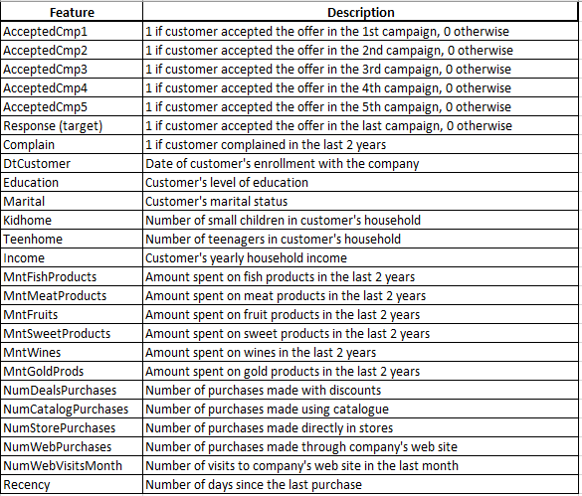
Data Dictionary

Slide 5
Business Problems
A startup company is holding an annual sales meeting to assess their overall performance and to strategize for future sales. Using historical data, prepare a report to understand the customer base, analyze their buying habits and product preferences, and derive actionable insights to boost sales and customer experience.

Slide 6
Customer Segmentation
Customer segmentation is the process by which you divide your customers up based on common characteristics – such as demographics, geography and income bracket etc.
This enables marketing teams and sales team can reach out to those customers more effectively.

Slide 7
Customer Segmentation
In this presentation we will perform analysis w. r. t. of segmentations based on the following:
Marital Status
Educational Class
Geographical Segmentation (on the basis of Country)
Generational Segmentation (on the basis of Age Brackets)
Income Bracket

Slide 8
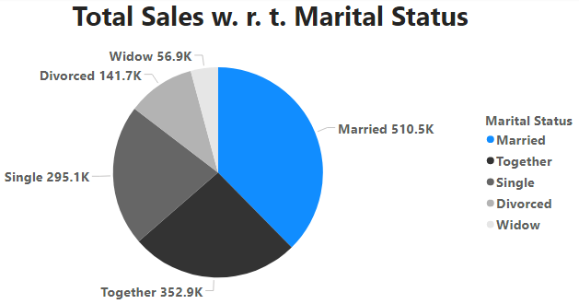
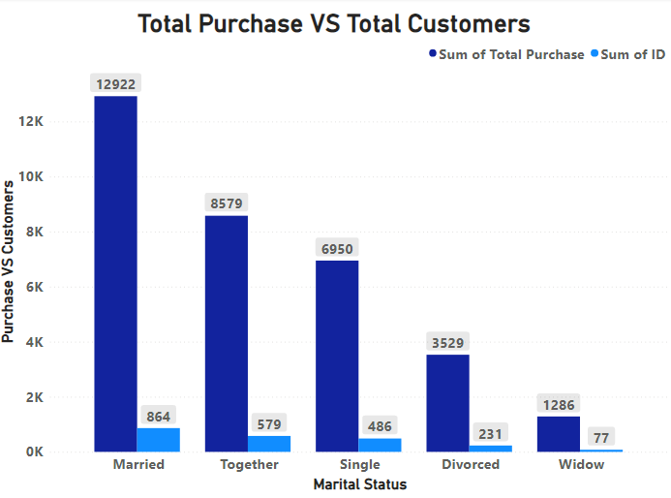
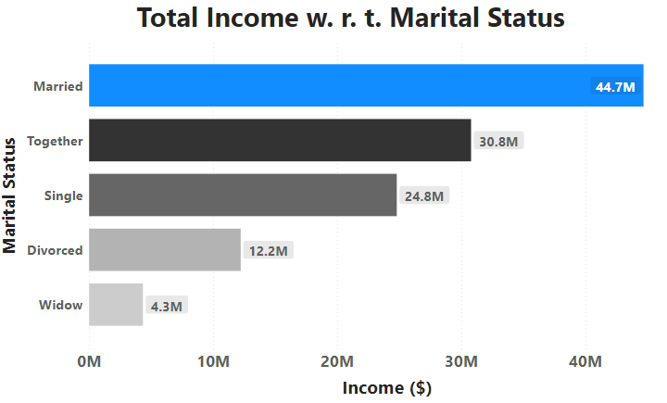
Analysis w. r. t. Marital Status
Marital Status | Total Purchase | Total Customers | Income ($) | Total Sales ($)
Married | 12,856 | 864 | $44.68 million | $ 510,453
Together | 8,647 | 579 | $30.78 million | $ 351,012
Single | 6,996 | 486 | $24.79 million | $ 295,093

Slide 9
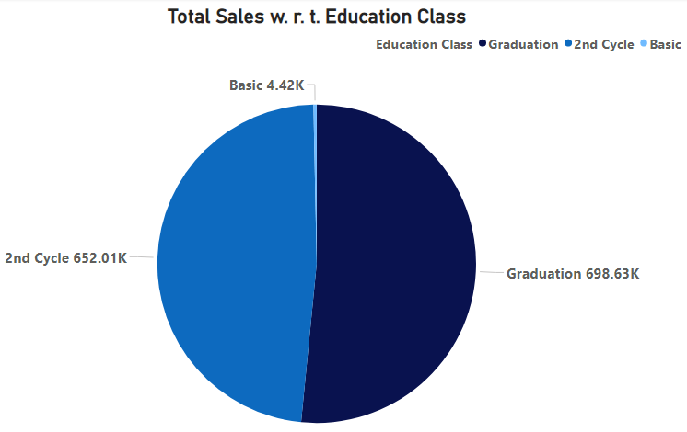
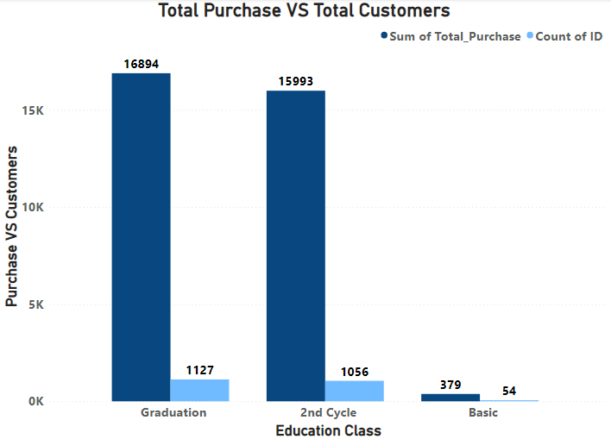
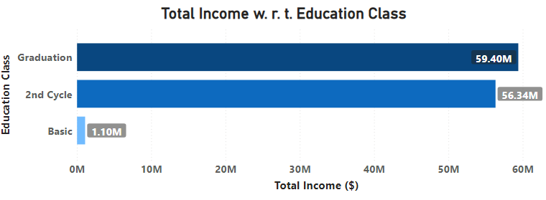
Analysis w. r. t. Education Class
Education Class | Total Purchase | Total Customers | Income ($) | Total Sales ($)
Graduation | 16,894 | 1,127 | $59.40 million | $ 698,625
2nd Cycle | 15,993 | 1,056 | $56.34 million | $ 652,005
Basic | 379 | 54 | $1.10 million | $4,417

Slide 10
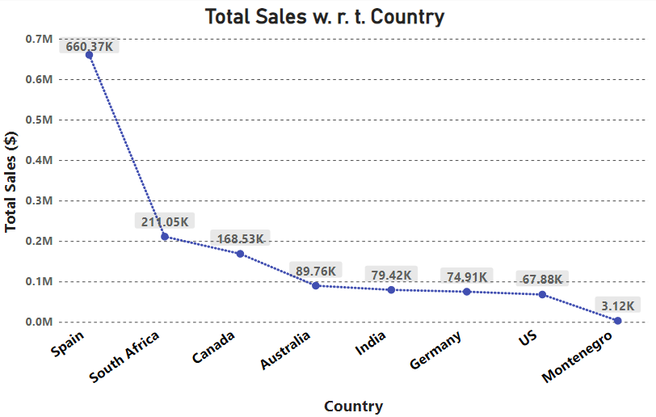
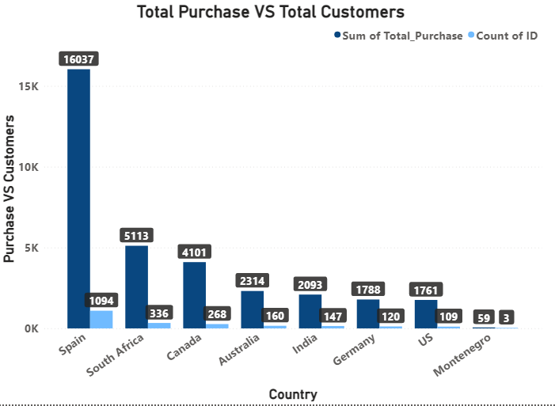
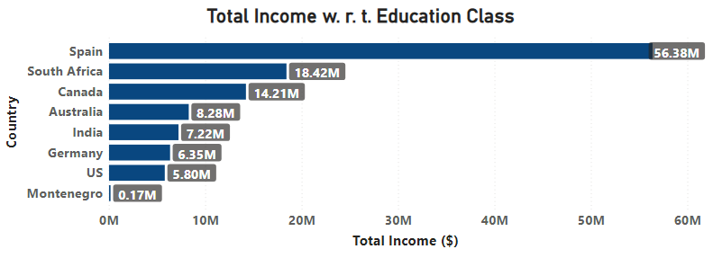
Analysis w. r. t. Country
Country | Total Purchase | Total Customers | Income ($) | Total Sales ($)
Spain | 16,037 | 1,094 | $56.38 million | $ 660,367
South Africa | 5,113 | 336 | $18.42 million | $ 211,049
Canada | 4,101 | 268 | $14.21 million | $ 168,532

Slide 11
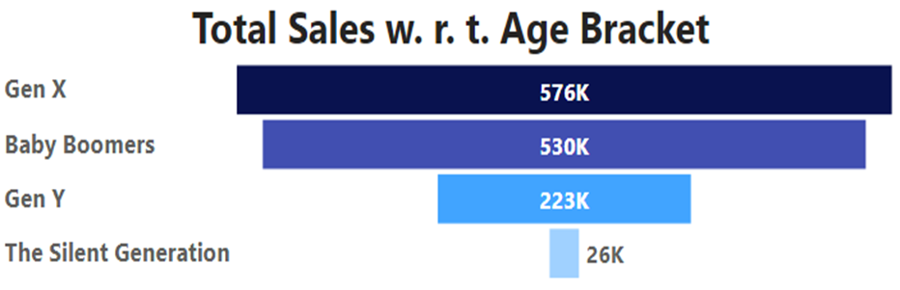
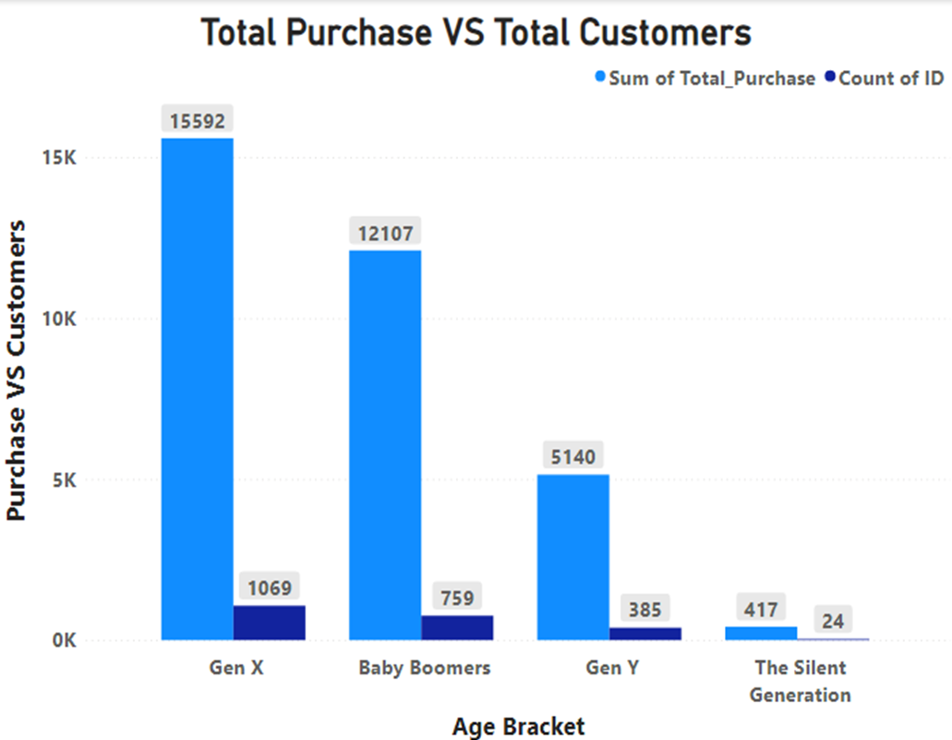
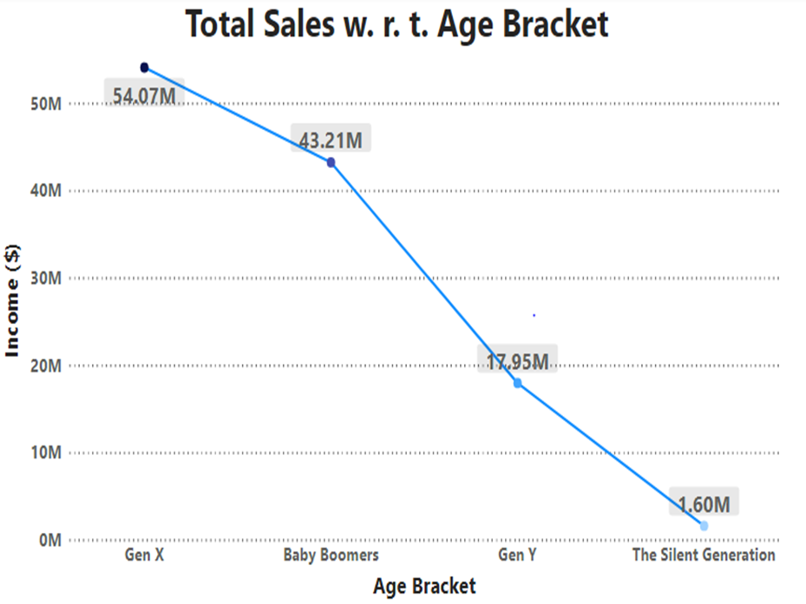
Generation | Total Purchase | Total Customers | Income ($) | Total Sales ($)
Gen X | 15,592 | 1,069 | $54.07 million | $ 576,130
Baby Boomers | 12,107 | 759 | $43.21 million | $ 530,428
Gen Y | 5,140 | 385 | $17.95 million | $ 222,666

Slide 12
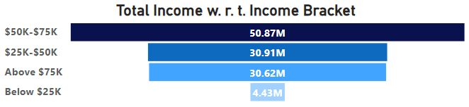
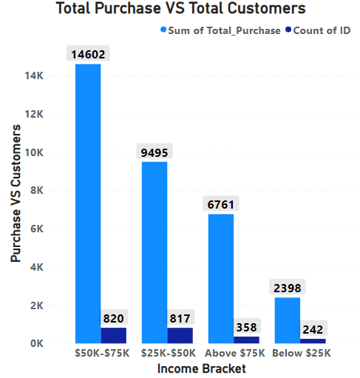
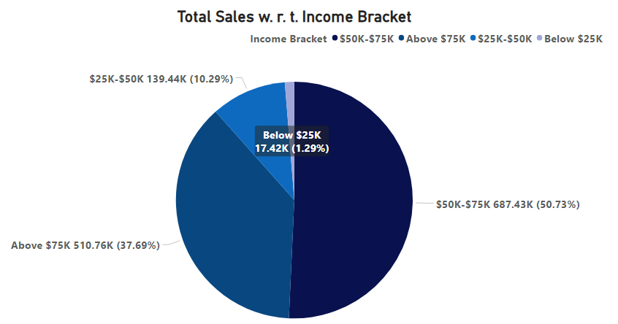
Analysis w. r. t. Income Bracket
Income Bracket | Total Purchase | Total Customers | Income ($)
$50K-$75K | 14,602 | 820 | $50.8 million
$25K-$50K | 9,495 | 817 | $30.9 million
Above $75K | 6,761 | 358 | $30.62 million
Income Bracket | Total Sales ($)
$50K-$75K | $ 687,434
Above $75K | $ 510,755
$25K-$50K | $ 139,441

Slide 13
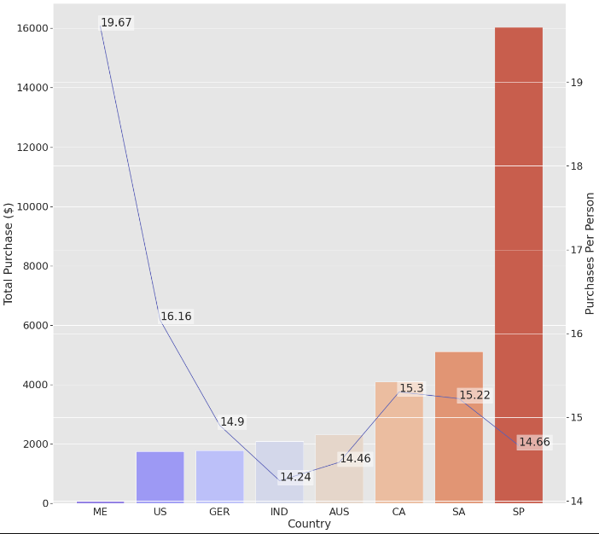
Contrast between Total Purchase and Purchase per Person
Country | Total Purchase | Customers | Purchase Per Perspon
Montenegro | 59 | 3 | 19.67
United States | 1,761 | 109 | 16.16
Canada | 4,101 | 268 | 15.30
South Africa | 5,113 | 336 | 15.22
Germany | 1,788 | 120 | 14.90
Spain | 16,037 | 1094 | 14.66
Australia | 2,314 | 160 | 14.46
India | 2,093 | 147 | 14.24
Customers from Spain (SP) have made the highest number of purchases as well as have spent the most dollars on sales.
However, the highest number of total purchase per person is carried out by Montenegro followed by the US.

Slide 14
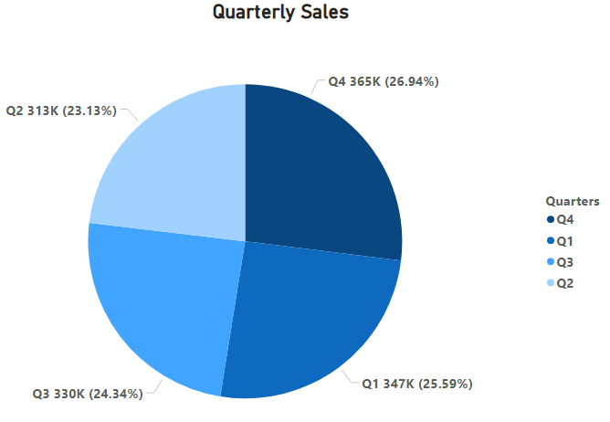
Quarterly Sales
Quarter | Total Sales ($) | Total Sales Percentage
Q4 | $365,114 | 26.94%
Q1 | $346,701 | 25.59%
Q3 | $329,788 | 24.34%
Quarter 4 brought the highest sales in comparison to the remaining three quarters.

Slide 15
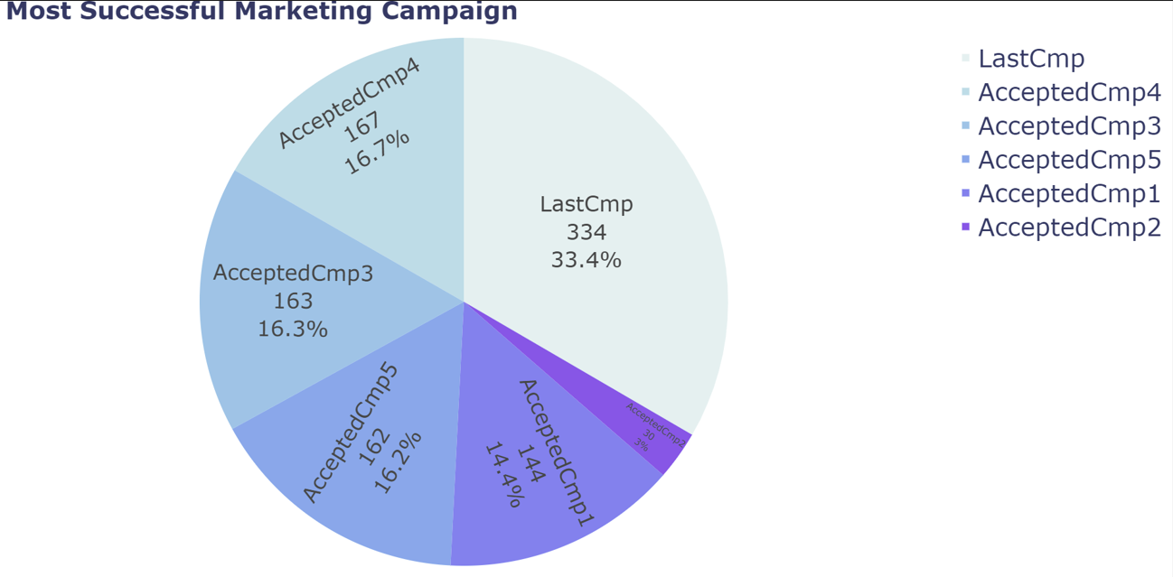
Most Successful Marketing Campaign
Campaign | Total Acceptance
LastCmp | 334
AcceptedCmp4 | 167
AcceptedCmp3 | 163
The last campaign (LastCmp) had the highest number of customer acceptances.

Slide 16
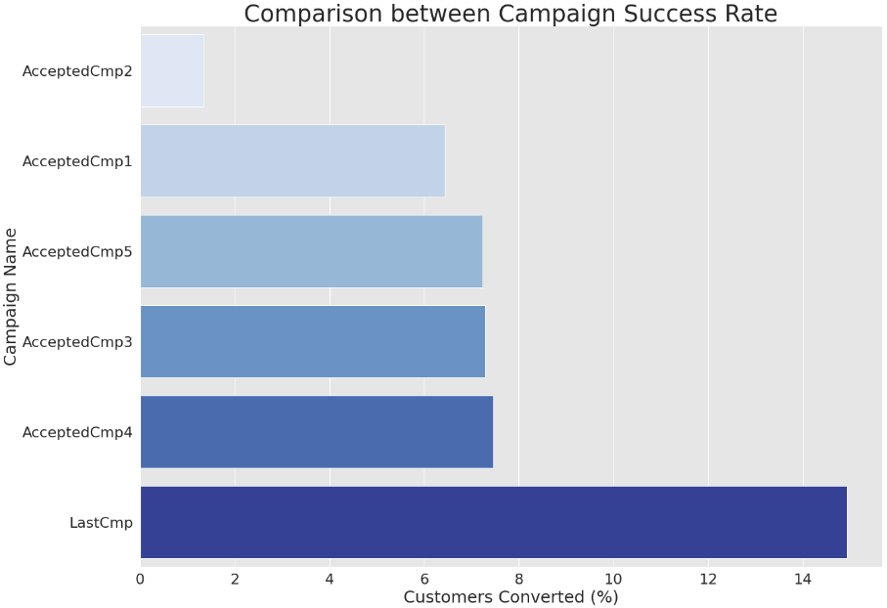
Marketing Campaign with Highest Success Rate
Success Rate: We can define success rate of a campaign as the percentage of customers who accepted that campaign or subscribed to the services or made a purchase in that campaign.
Marketing Campaign | Success Rate
LastCmp | 14.93%
AcceptedCmp4 | 7.46%
AcceptedCmp3 | 7.28

Slide 17
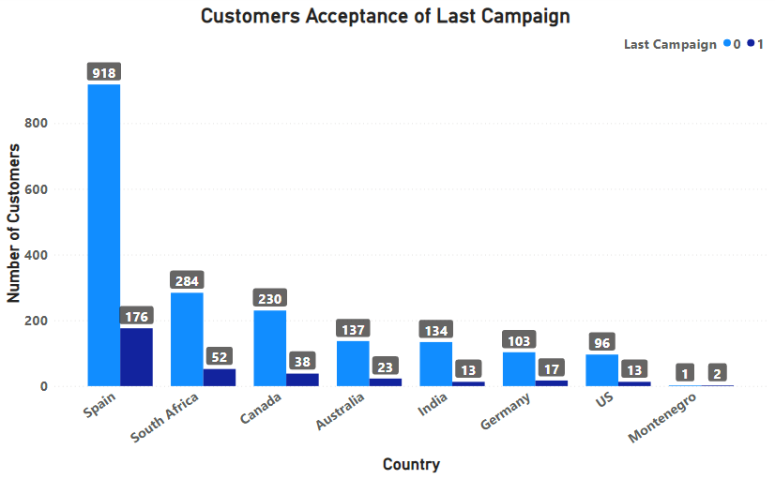
Customers Acceptance of Last Campaign w. r. t. Country
Country | Total Customer Acceptance
Spain | 176
South Africa | 52
Canada | 38
Off all the countries, customers from Spain had the highest number of campaign acceptances.

Slide 18
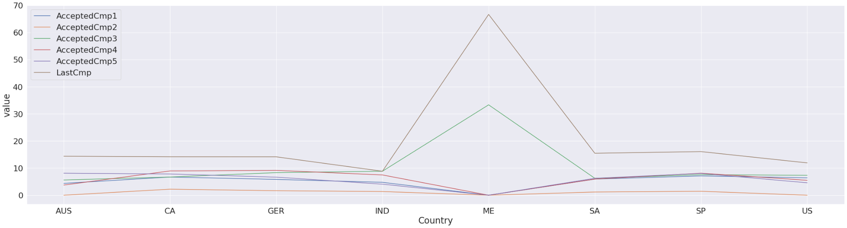
Relationship between Country and Success of Campaign
Country | AcceptedCmp1 | AcceptedCmp2 | AcceptedCmp3 | AcceptedCmp4 | AcceptedCmp5 | LastCmp
Australia | 4.375 | 0.00 | 5.625 | 3.750 | 8.125 | 14.375
Canada | 6.716 | 2.239 | 6.716 | 8.955 | 7.836 | 14.179
Germany | 5.833 | 1.667 | 8.333 | 9.167 | 6.667 | 14.167
India | 4.762 | 1.361 | 8.844 | 7.483 | 4.082 | 8.844
Montenegro | 0.00 | 0.000 | 33.333 | 0.00 | 0.00 | 66.667
South Africa | 5.952 | 1.190 | 6.250 | 5.952 | 6.250 | 15.476
Spain | 7.130 | 1.463 | 7.587 | 8.135 | 8.044 | 16.088
US | 6.422 | 0.00 | 7.339 | 5.505 | 4.587 | 11.927
Apparently, there is no relationship between a country and success of campaign.

Slide 19
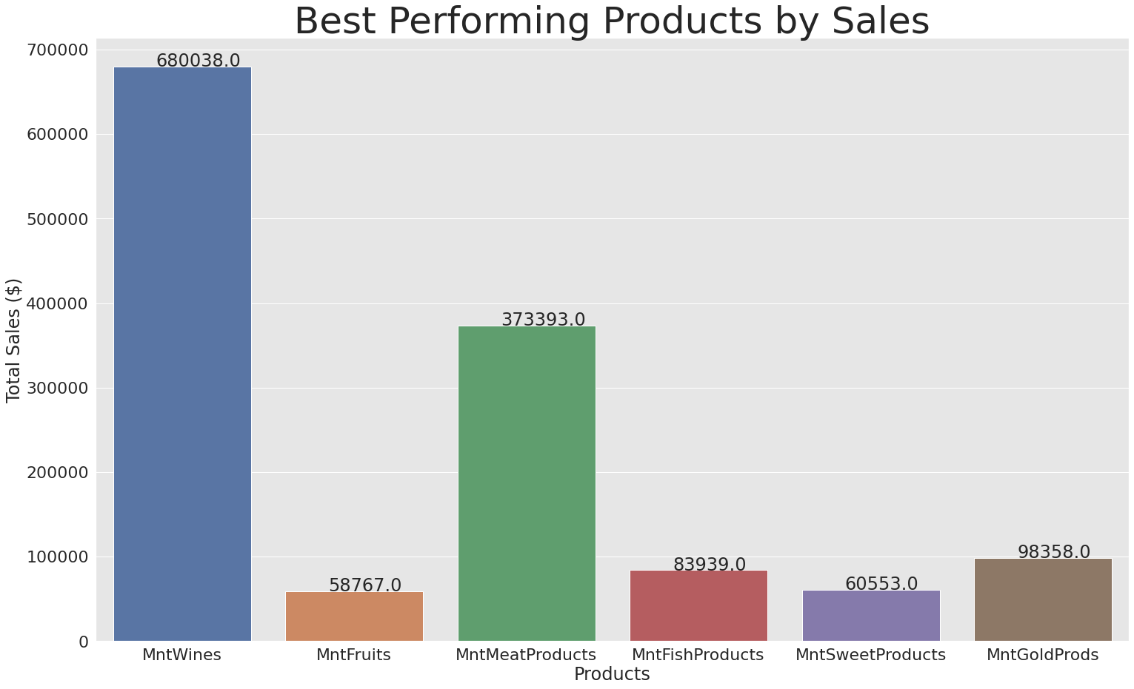
Best Performing Products w. r. t. Sales
Products | Total Sales ($)
Wine | $680,038
Meat | $373,393
Gold | $98,358
Wine is the best performing product.

Slide 20
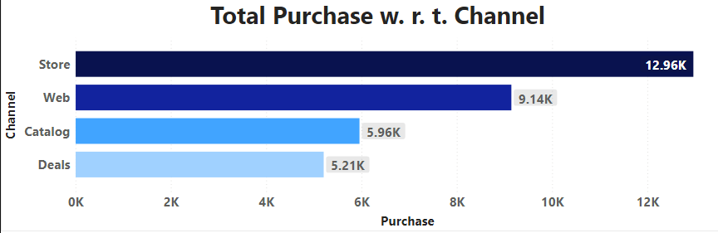
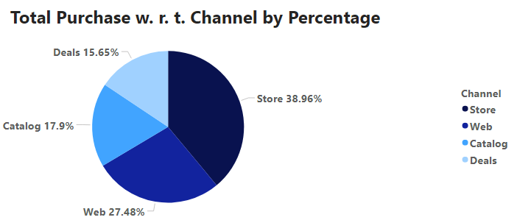
Channel Performance (Total Number of Purchase w. r. t. Channels)
Channel | Purchase Count | Purchase Percentage
Store | 12,962 | 39%
Web | 9,143 | 27%
Catalog | 5,956 | 18%

Slide 21
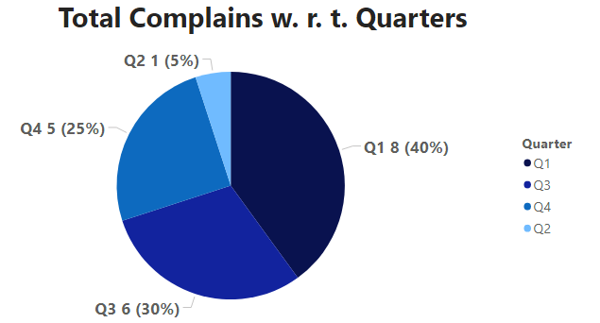
Analysis of Customer Complains
Total Complains w. r. t. Quarters
Quarter | Number of Complains
Q1 | 8
Q3 | 6
Q4 | 5
Q2 | 1
Quarter 1 received the most number of complains.

Slide 22
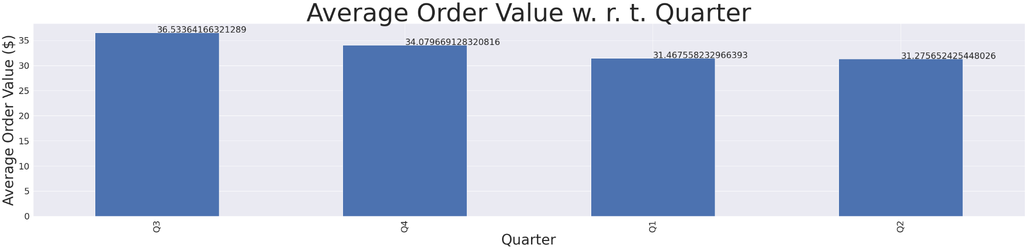
Average Order Value (Quarterly)
Average Order Value: AOV is the ratio of the total revenue and the number of orders placed.
It usually tracks the average dollar amount spent each time a customer places an order on a website or mobile app.
Quarter | AOV ($)
Q3 | $36.5
Q4 | $34.07
Q1 | $31.46

Slide 23
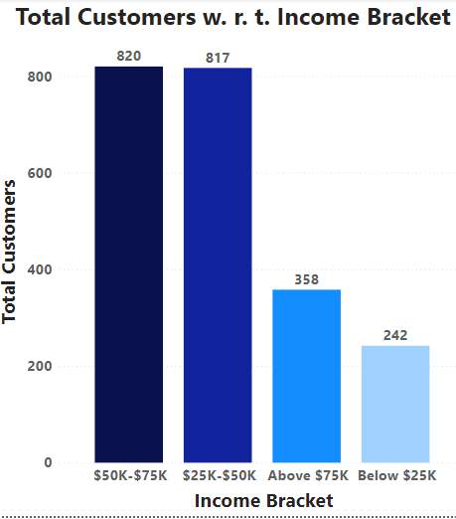
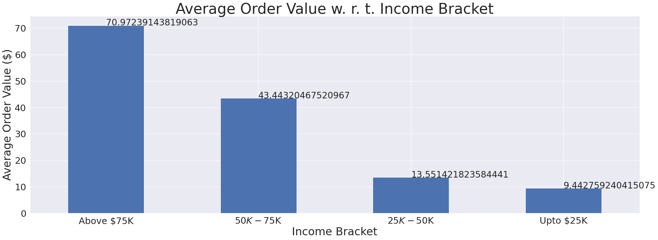
Average Order Value (w. r. t. Income Bracket)
Income Bracket | AOV ($) | Total Customers
Above $75K | $70.97 | 358
$50K-$75K | $43.33 | 820
$25K-$50K | $13.55 | 817
Over here we can see the customers earning above $75K annually have the highest average order value despite their population being considerably less than customers earning within the range of $50K-$75K and $25K-$50K.

Slide 24
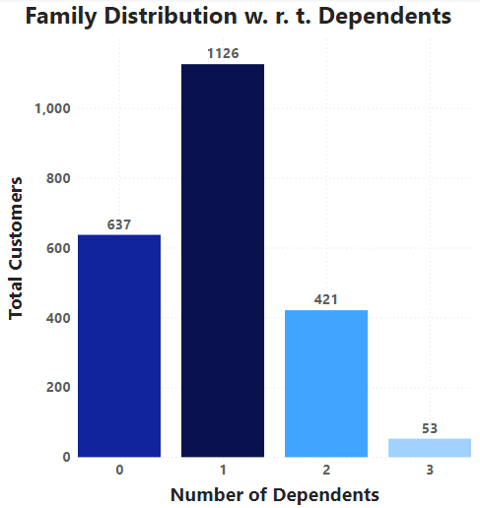
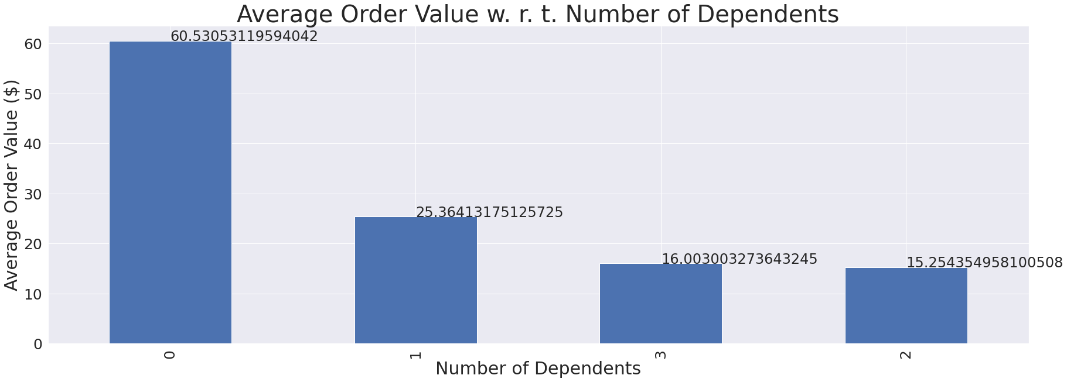
Average Order Value (w. r. t. Dependents)
Dependents | AOV ($) | Count of families
0 | $60.53 | 637
1 | $25.36 | 1126
3 | $16.00 | 53
2 | $15.25 | 421
Surprisingly, customers with 0 dependents have the highest average order value keeping in mind that their population is significantly less than customers having 1 dependent.

Slide 25
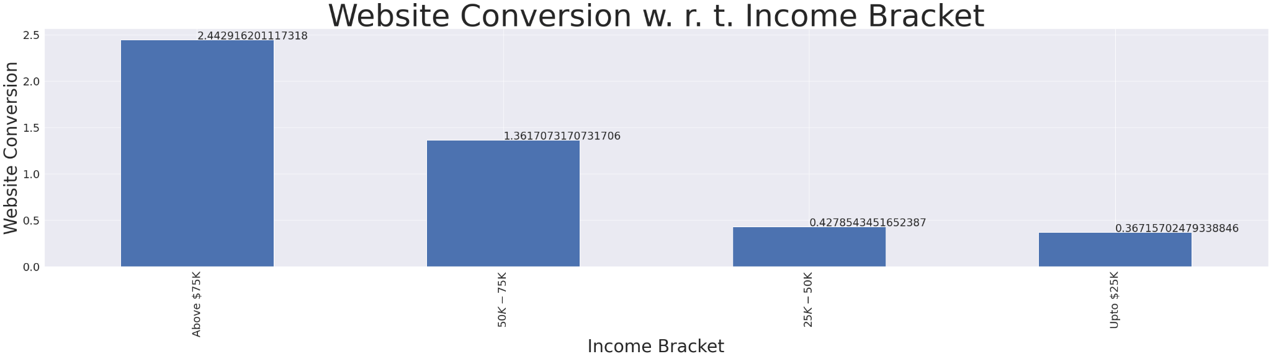
Website Conversion Analysis
A website conversion is when a user completes a desired action on your website, like signing up for a newsletter, sharing a blog post to social media, buying a product or filling out a contact form.
Every business website is built to generate conversions. The percentage of people that complete your desired action is your conversion rate.
Here we are calculating Website conversion using the following relation=
(Number of Web Purchase/ Number of website visits)​
Income Bracket | Website Conversion
Above $75K | 2.44
$50K-$75K | 1.36
$25k-$50K | 0.42
This means there is greater acceptability of e-commerce and online ordering services within customers of upper segments.

Slide 26
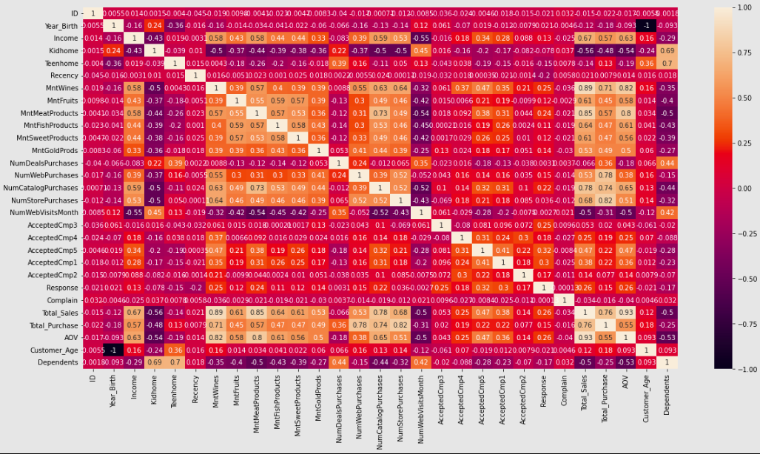
Correlation between various features

Slide 27
From this heatmap we can observe the following clusters of correlated features:
A. The "Income" cluster:
1. The total amount spent ('Total_Sales' and other sales features containing the term 'Mnt') and total number of purchases ('Total_Purchase' and other features containing the term 'Num...Purchases' features) are positively correlated with 'Income'
2. Purchasing in store, on the web, or via the catalog ('NumStorePurchases', 'NumWebPurchases', 'NumCatalogPurchases') is positively correlated with 'Income'.

Slide 28
B. The "Dependency" cluster:
1. The total amount spent ('Total_Sales' and other features containing the term 'Mnt') and number of purchases ('Total_Purchase' and other features containing the term 'Num...Purchases') are negatively correlated with 'Dependents' features.
2. The number of deal purchases ('NumDealsPurchases') is positively correlated with 'Dependents' feature (kids and/or teens) and negatively correlated with 'Income'

Slide 29
Anomalies:
Surprisingly, the number of website visits in the last month ('NumWebVisitsMonth') does not correlate with an increased number of web purchases ('NumWebPurchases') (-0.52)
Instead, 'NumWebVisitsMonth' is positively correlated with the number of deals purchased ('NumDealsPurchases'), suggesting that deals should be preferred to stimulate purchases on the website. (0.35)

Slide 30
Conclusion
Married Couples have the highest total income, sales and number of purchase, and account for most customers distributed w. r. t. marital status.
Graduate customers have the highest total income, sales and number of purchase, and account for most customers distributed w. r. t. education class.
Customers from Spain have the highest total income, sales and number of purchase and account for most customers w. r. t. geographical segmentation by country.
Generation X customers have the highest total income, sales and number of purchase and account for most customers w. r. t. generational segmentation.
Customers within $50K-$75K Income Bracket have the highest total income, sales and number of purchase and account for most customers distributed w. r. t. income bracket.
Montenegro has the highest purchase per person followed by the US.
Quarterly sales among all quarters all approximately the same.
The last campaign (LastCmp) is the most successful in terms positive (‘Yes’) responses as well as it has the highest success rate.
Geographically, the last campaign is the most successful in Spain.
Apparently, there is no relationship between a country and success of campaign.
Among all products, wine is the best performing product.
Store is the best performing channel.
First quarter (Q1) has received the most number of complains.

Slide 31
Conclusion
The Average Order Value (AOV) is highest in third quarter (Q3) but approximately same in the remaining quarters.
Customers earning above $75K have the highest average order value.
Although customers with 0 dependents do not make greatest share w. r. t. family distribution, they have the highest average order value.
Customers earning above $75K have the highest website conversion reflecting their acceptability of e-commerce.

Slide 32
Recommendations
Appropriate measures (like offering rewards and discounts) must be taken to gain customers via underperforming channels (deals and catalog purchases) since the average customer made the fewest purchases via these channels i. e. catalogs and deals.
Advertising campaigns, deals and promotions must be launched with a special focus on boosting sales of the less popular items such as fish, fruits sweets and gold.
The first quarter (Q1) gets the most number of complains which is not a welcome way to start the year. Therefore, the quality control team must perform due diligence, specially by the end of fourth quarter (Q4) to minimize complains in the beginning of a calendar year.
The website development and design team must improve the user interface of website (e. g. optimize layout of critical pages) in order to attract customers from all segments, enhance their user experience and increase overall website conversion.
More deals must be offered since they appear to be a constructive way to amplify purchases on the website.

